Slide 1
Wired RIP

Slide 2
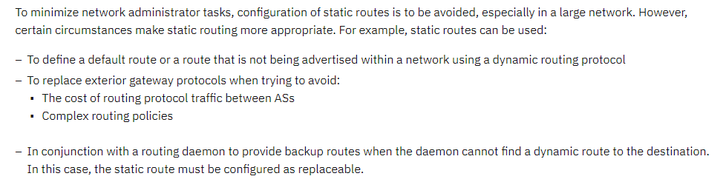
Introduction
An internet is a combination of networks connected by routers. When a datagram goes from a source to a destination, it will probably pass through many routers until it reaches the router attached to the destination network.
Static versus Dynamic Routing Tables
A routing table can be either static or dynamic.
A static table is one with manual entries.
A dynamic table, on the other hand, is one that is updated automatically when there is a change somewhere in the internet. Today, an internet needs dynamic routing tables. The tables need to be updated as soon as there is a change in the internet. For instance, they need to be updated when a link is down, and they need to be updated whenever a better route has been found.
Routing Protocol
The sharing of information allows a router in San Francisco to know about the failure of a network in Texas. The routing protocols also include procedures for combining information received from other routers.

Slide 3
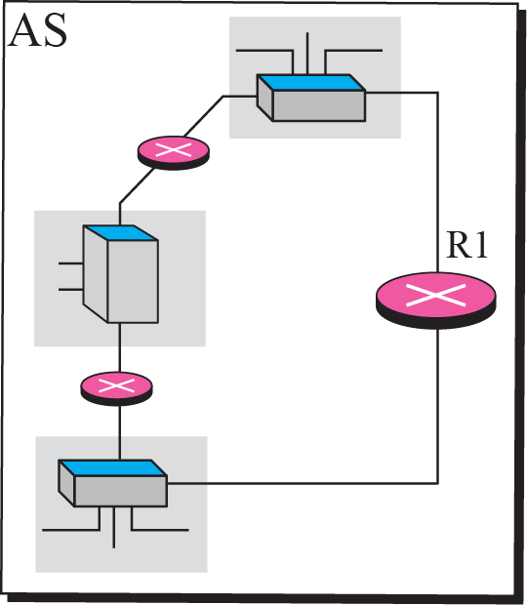
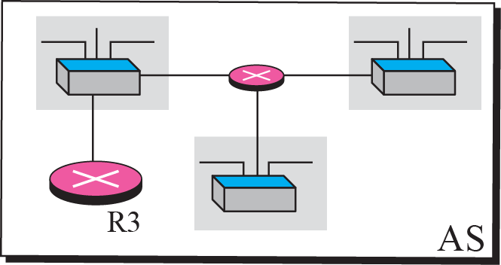
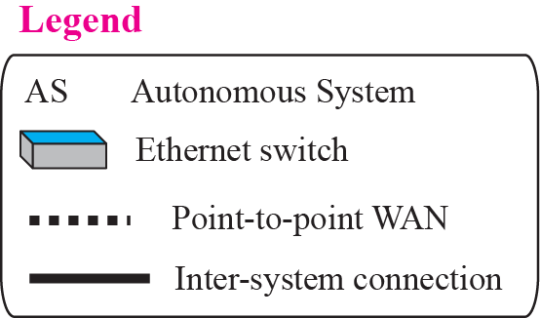
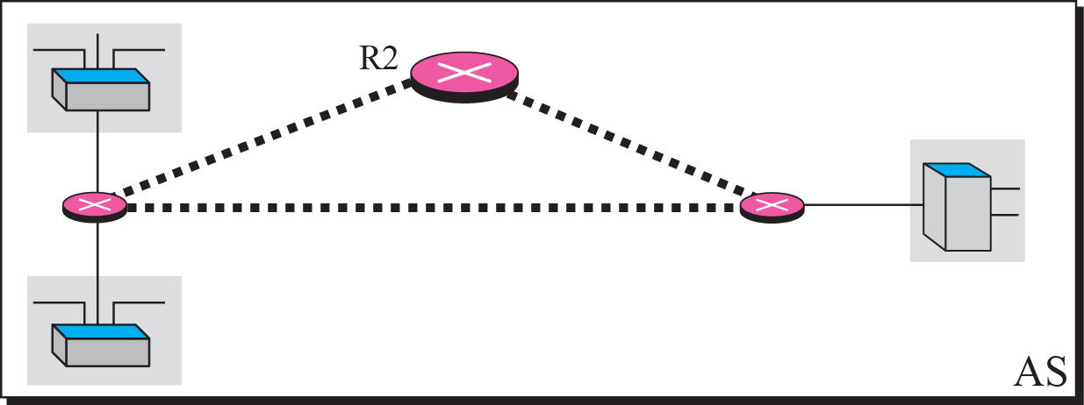
Today, an internet can be so large that one routing protocol cannot handle the task of updating the routing tables of all routers. For this reason, an internet is divided into autonomous system0s.
An autonomous system (AS) is a group of networks and routers under the authority of a single administration. Routing inside an autonomous system is called intra-domain routing. Routing between autonomous systems is called inter-domain routing

Slide 4
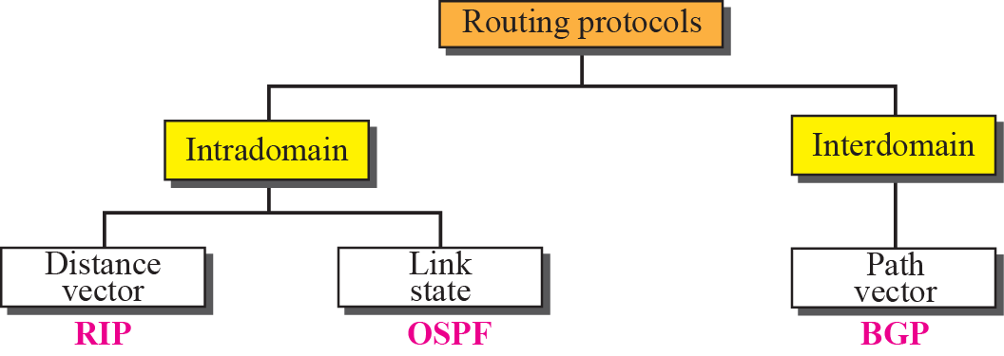

Slide 5
Distance vector routing
All routers and networks, as represented as a graph, a set of nodes and lines (edges) connecting the nodes.
A router can normally be represented by a node and a network by a link connecting two nodes.
The graph theory used an algorithm called Bellman-Ford (also called Ford-Fulkerson) for a while to find the shortest path between nodes in a graph given the distance between nodes.

Slide 6
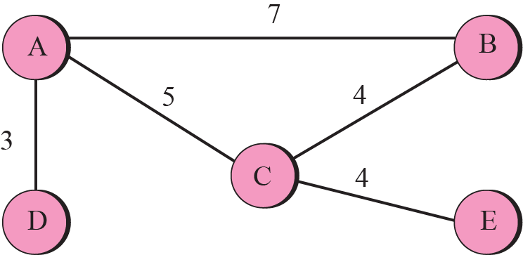
A graph for Bellman-Ford algorithm

Slide 7
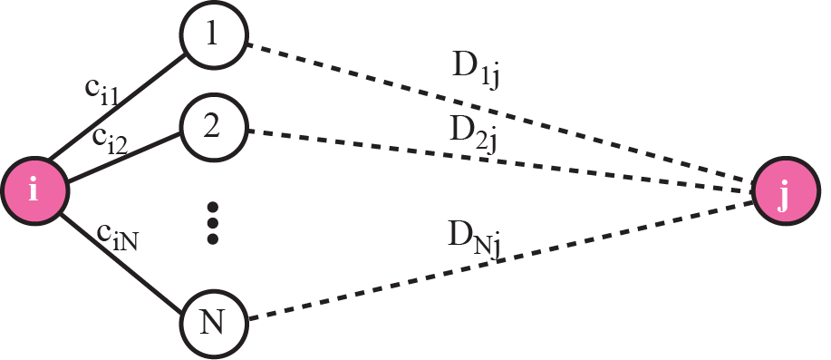
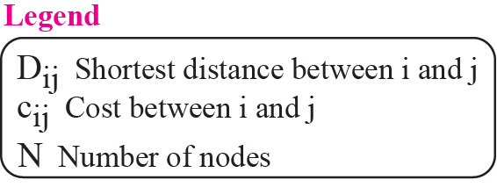
The fact behind Bellman-Ford algorithm

Slide 8
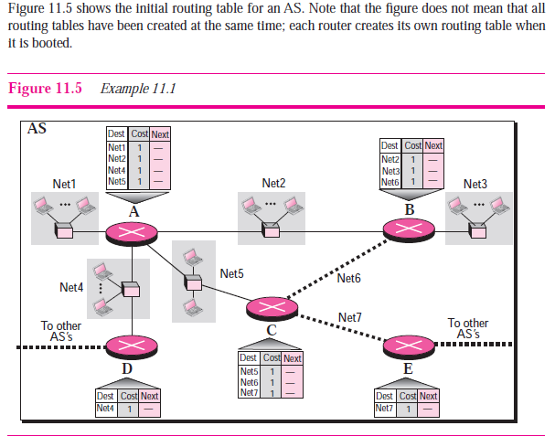

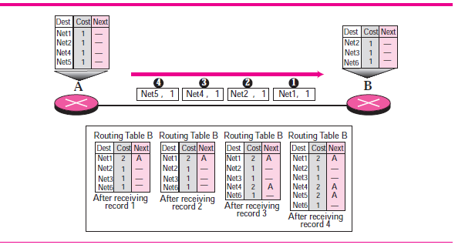

Slide 9
Count to Infinity
A problem with distance vector routing is that any decrease in cost (good news) propagates quickly, but any increase in cost (bad news) propagates slowly. For a routing protocol to work properly, if a link is broken (cost becomes infinity), every other router should be aware of it immediately, but in distance vector routing, this takes some time.
The problem is referred to as count to infinity. It takes several updates before the cost for a broken link is recorded as infinity by all routers.

Slide 10
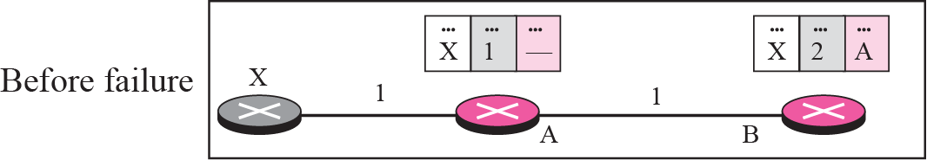
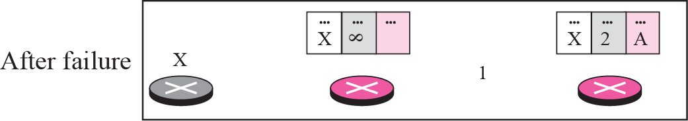
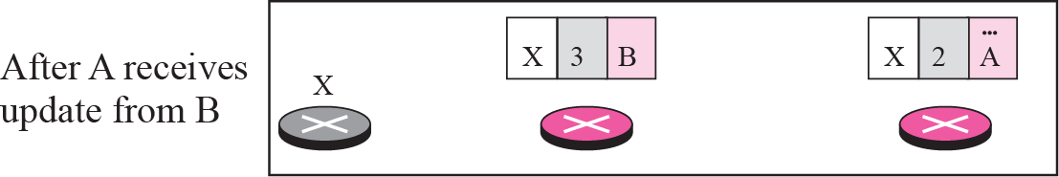
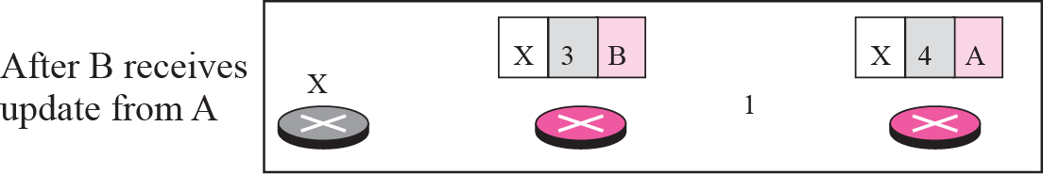
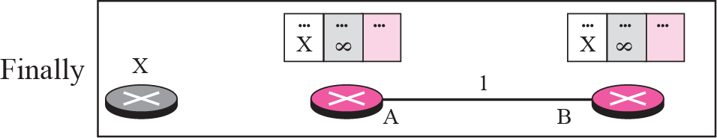
Figure 11.8 Two-node instability

Slide 11
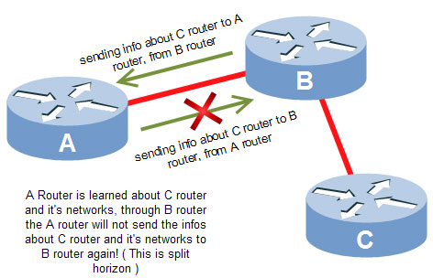
Two-Node Instability
Defining Infinity
Most implementations define 16 as infinity
Split Horizon
Instead of flooding the table through each interface, each node sends only part of its table through each interface
E.g. node B thinks that the optimum route to reach X is via A, it does not need to advertise this piece of information to A

Slide 12
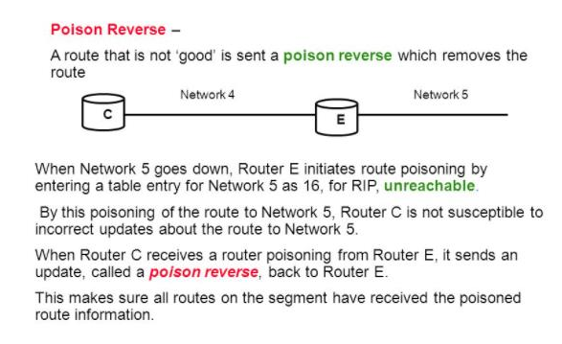
Two-Node Instability
Split Horizon and Poison Reverse
One drawback of Split Horizon
Normally, the DV protocol uses a timer and if there is no news about a route, the node deletes the route from its table
In the previous e.g., node A cannot guess that this is due to split horizon or because B has not received any news about X recently
Poison Reverse
Node B can still advertise the value for X, but is the source of information is A, it can replace the distance with infinity as a warning

Slide 13
RIP
The Routing Information Protocol (RIP) is an intra-domain (interior) routing protocol used inside an autonomous system. It is a very simple protocol based on distance vector routing. RIP implements distance vector routing directly with some considerations.
1. In an autonomous system, we are dealing with routers and networks (links), what
was described as a node.
2. The destination in a routing table is a network, which means the first column
defines a network address.
3. The metric used by RIP is very simple; the distance is defined as the number of
links (networks) that have to be used to reach the destination. For this reason, the
metric in RIP is called a hop count.
4. Infinity is defined as 16, which means that any route in an autonomous system
using RIP cannot have more than 15 hops.
5. The next node column defines the address of the router to which the packet is to be
sent to reach its destination.

Slide 14
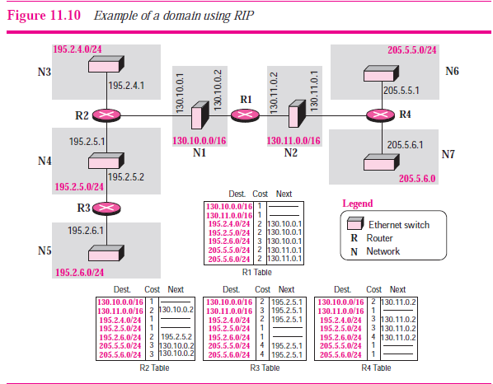
RIP
The Routing Information Protocol (RIP) is an intra-domain (interior) routing protocol used inside an autonomous system. It is a very simple protocol based on distance vector routing. RIP implements distance vector routing directly with some considerations.

Slide 15
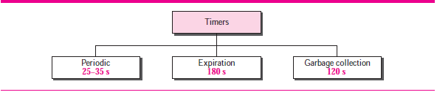
RIP Timers
Periodic timer
It controls the advertising of regular update message (25 ~ 30 sec)
Each router has one periodic timer that is randomly set to a number between 25 and 35. It counts down; when zero is reached, the update message is sent, and the timer is randomly set once again.
Expiration timer
It governs the validity of a route (180 sec)
When a router receives update information for a route, the expiration timer is set to 180 s for that particular route. Every time a new update for the route is received, the timer is reset.
The route is considered expired and the hop count of the route is set to 16.
Garbage collection timer
A invalid route is not purged from the routing table until this timer expires (120 sec)
When the information about a route becomes invalid, the router does not immediately purge that route from its table. Instead, it continues to advertise the route with a metric value of 16.

Slide 16
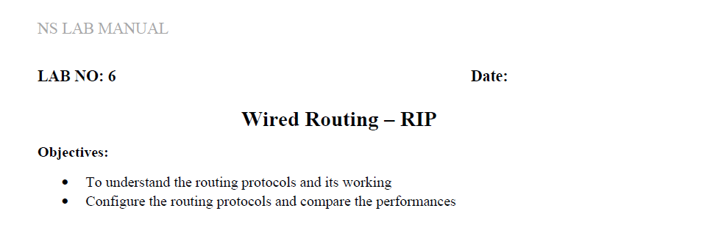

Slide 17
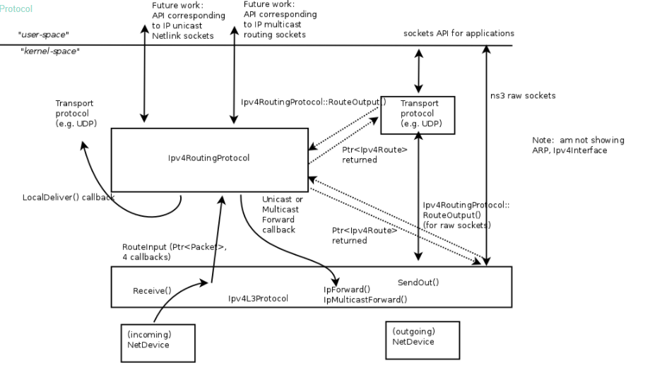
Routing architecture
Code explanation

Slide 18
Routing architecture
The key objects are Ipv4L3Protocol, Ipv4RoutingProtocol(s) (a class to which all routing/forwarding has been delegated from Ipv4L3Protocol), and Ipv4Route(s).
Ipv4L3Protocol must have at least one Ipv4RoutingProtocol added to it at simulation setup time. This is done explicitly by calling Ipv4::SetRoutingProtocol ().
The abstract base class Ipv4RoutingProtocol () declares a minimal interface, consisting of two methods: RouteOutput () and RouteInput ().
For packets traveling outbound from a host, the transport protocol will query Ipv4 for the Ipv4RoutingProtocol object interface, and will request a route via Ipv4RoutingProtocol::RouteOutput (). A Ptr to Ipv4Route object is returned.
This is analogous to a dst_cache entry in Linux. The Ipv4Route is carried down to the Ipv4L3Protocol to avoid a second lookup there. However, some cases (e.g. Ipv4 raw sockets) will require a call to RouteOutput() directly from Ipv4L3Protocol.

Slide 19
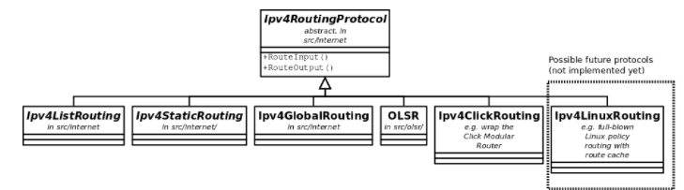
Routing architecture
For packets received inbound for forwarding or delivery, the following steps occur. Ipv4L3Protocol::Receive() calls Ipv4RoutingProtocol::RouteInput(). This passes the packet ownership to the Ipv4RoutingProtocol object. There are four callbacks associated with this call:
LocalDeliver
UnicastForward
MulticastForward
Error
The Ipv4RoutingProtocol must eventually call one of these callbacks for each packet that it takes responsibility for. This is basically how the input routing process works in Linux
Ipv4L3Protocol must have at least one Ipv4RoutingProtocol added to it at simulation setup time. This is done explicitly by calling Ipv4::SetRoutingProtocol ().​

Slide 20
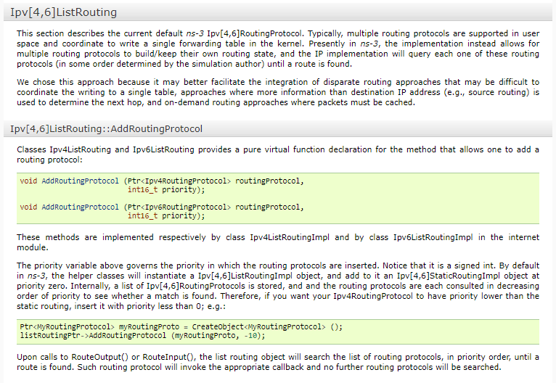

Slide 21
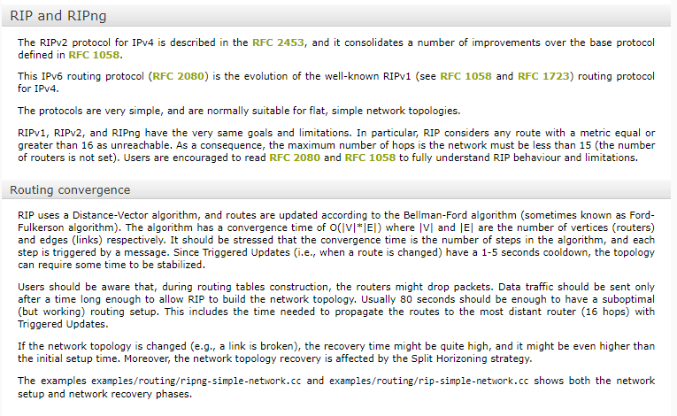

Slide 22
Routing Information Protocol next generation (RIPng)
The Routing Information Protocol next generation (RIPng) is an interior gateway protocol (IGP) that uses a distance-vector algorithm to determine the best route to a destination, using hop count as the metric.
RIPng exchanges routing information used to compute routes and is intended for IP version 6 (IPv6)-based networks. RIPng is disabled by default.

Slide 23
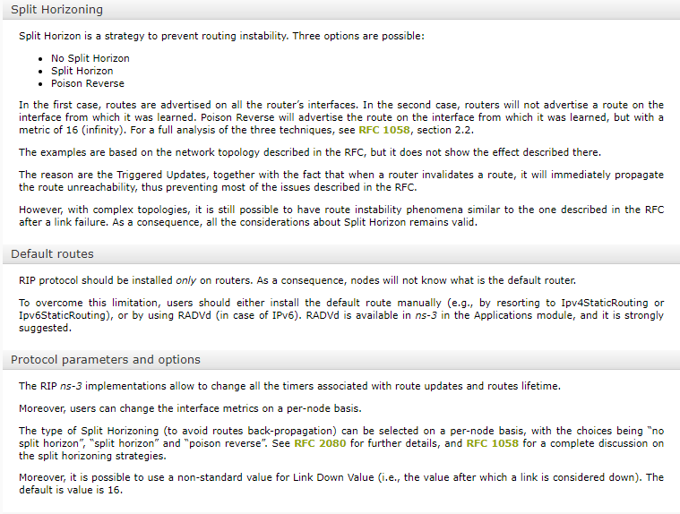
Ipv4L3Protocol must have at least one Ipv4RoutingProtocol added to it at simulation setup time. This is done explicitly by calling Ipv4::SetRoutingProtocol ().​

